Slide 1
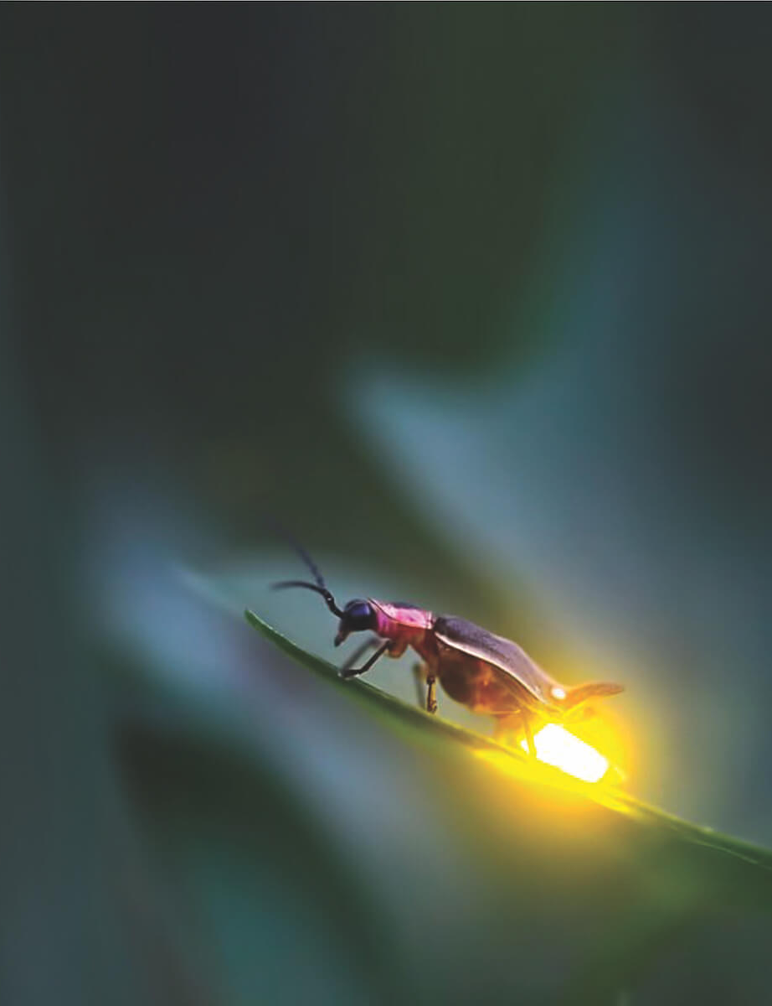
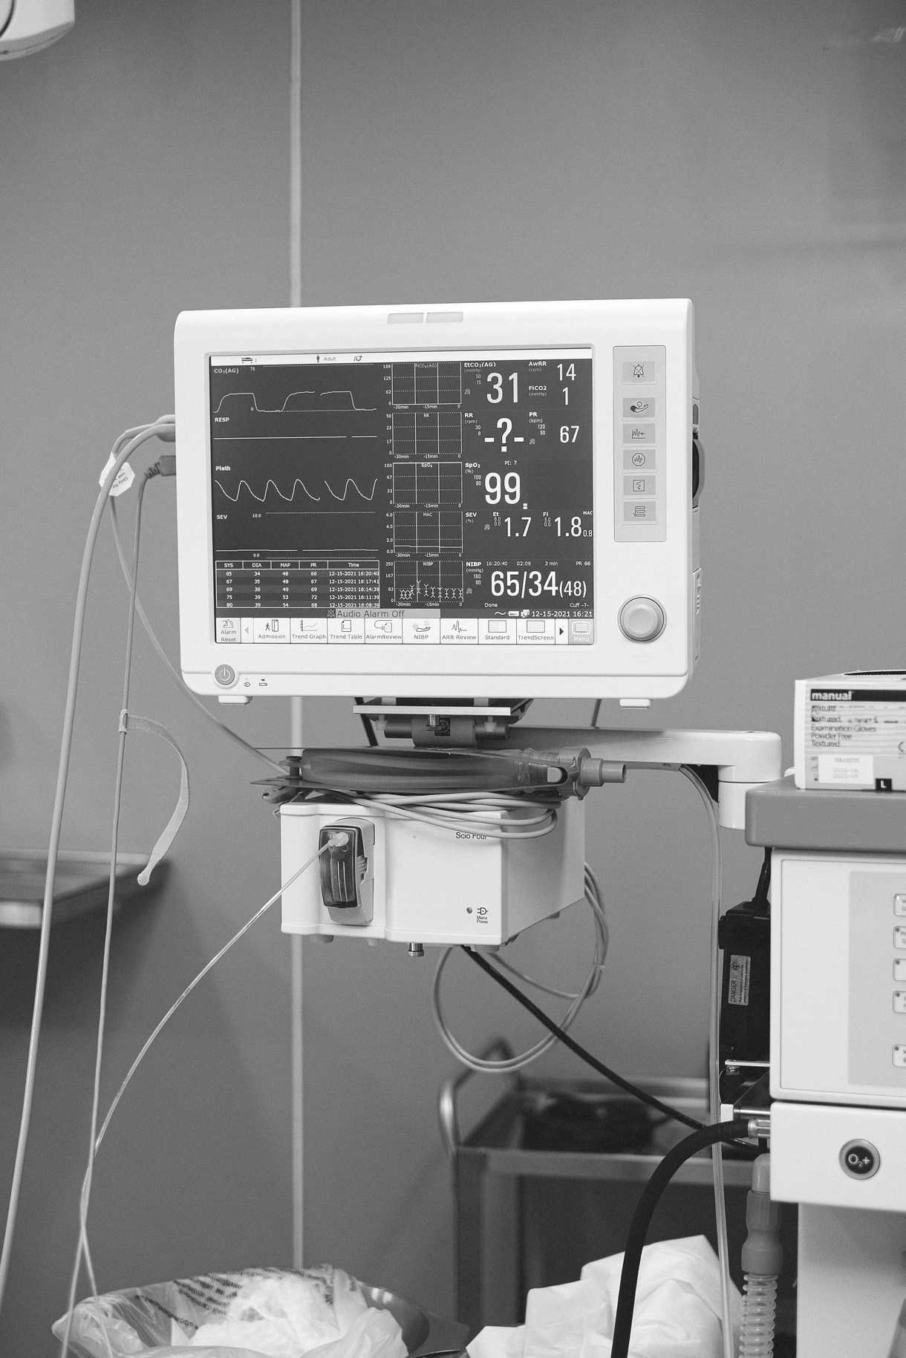

Firefly Algorithm

Slide 2


Presentation Outline
what is Firefly Algorithm?
How Firefly Algorithm Working Principle
Flowchart of FA
Graph
Result
Firefly Application

Slide 3

How Firefly Algorithm Working Principle
Firefly key points
Firefly Algorithm is inspired by flashing behavior of fireflies
Attractiveness is Proportional to Brightness
Less Brighter Firefly is attracted to the Brighter Firefly
Attractiveness decrease as distance between Two Fireflies increase

Slide 4


How Firefly Algorithm Working Principle
1. Initialize Objective Function f(xi) :-
In the simplest form, the light intensity I(r) varies according to the inverse square law.
Where, I(r) is the intensity at the source
r is the observers distance from source
If we take absorption coefficient γ into account, the light intensity I varies with the square of distance r

Slide 5

How Firefly Algorithm Working Principle
2. Generate Initial Population of Fireflies :-
initialize the Fireflies population (say n) by considering the following equation:-
here the second term is due to the attraction and third term is randomization with α being the randomization parameter.

Slide 6

How Firefly Algorithm Working Principle
3. Determine the Light Intensity Ii at xi via f(xi) :-
Now determine the light intensities of each of the fireflies to find out the brightness of every firefly.

Slide 7

How Firefly Algorithm Working Principle
4. Calculate the attractiveness of Fireflies :-
Evaluate the attractiveness of Fireflies :
5. Movement of Less Brighter Fireflies towards brighter one
The movement of the firefly i is attracted to another more attractive (brighter) firefly j is determined by :-

Slide 8
How Firefly Algorithm Working Principle
6. Update the Light Intensities, rank the fireflies and find the current best :-
Update the Light intensities of the Fireflies and rank the fireflies. After ranking of the fireflies, find the current best solution.

Slide 9
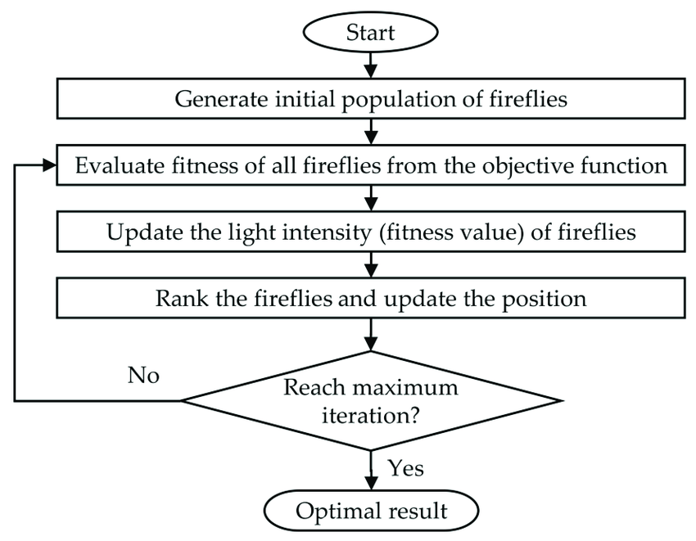
Flowchart of Firefly

Slide 10
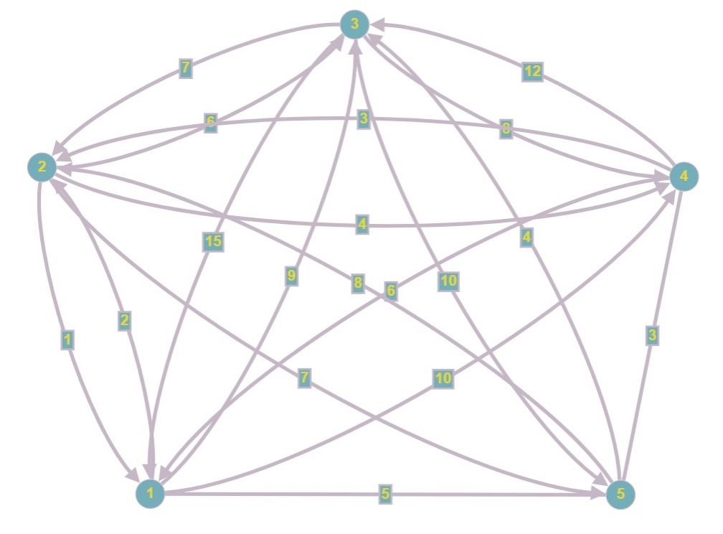
Graph

Slide 11

Result

Slide 12
Application Areas
For solving Travelling Salesman Problem
Structural design
Scheduling

Slide 13
Thank You
For Your Time!

